Slide 1

High Impact Skills Development Program
in Artificial Intelligence, Data Science, and Blockchain
Module 6: Data Mining Using SQL & NoSQL
Lecture 3 : Reading, Transforming and Loading Data into Data Sources
Instructor: Dr. Muhammad Bilal
Assistant Professor, SEECS, NUST

Slide 2
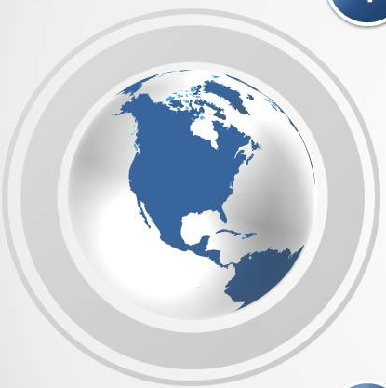

Contents
Transforming Data
Data Definition Language
Create Alter Drop
Data Manipulation language
Insert Update Delete

Slide 3

Transforming Data

Slide 4
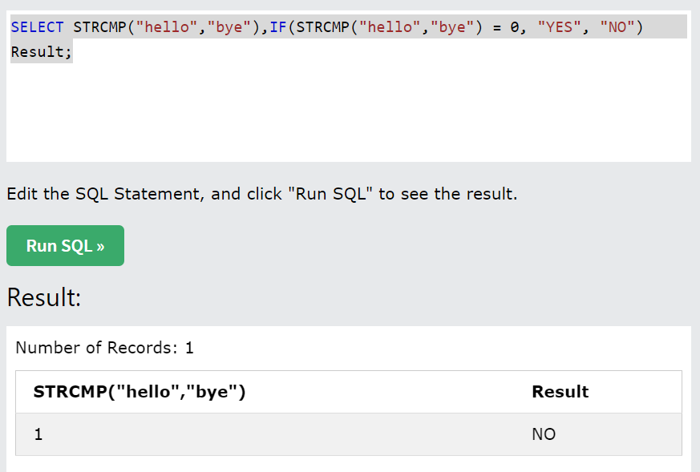
Data Transforming: IF
The IF() function returns a value if a condition is TRUE, or another value if a condition is FALSE.

Slide 5
Data Transforming: Case
The CASE statement goes through conditions and return a value when the first condition is met (like an IF-THEN-ELSE statement). So, once a condition is true, it will stop reading and return the result.
If no conditions are true, it will return the value in the ELSE clause.
If there is no ELSE part and no conditions are true, it returns NULL.

Slide 6
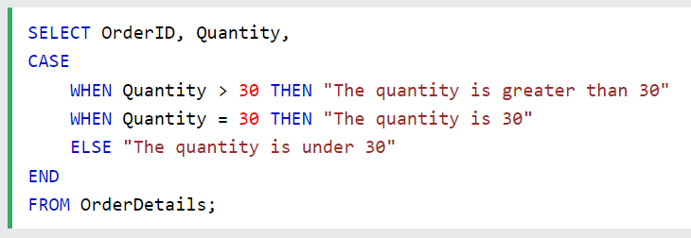
Data Transforming: Case

Slide 7
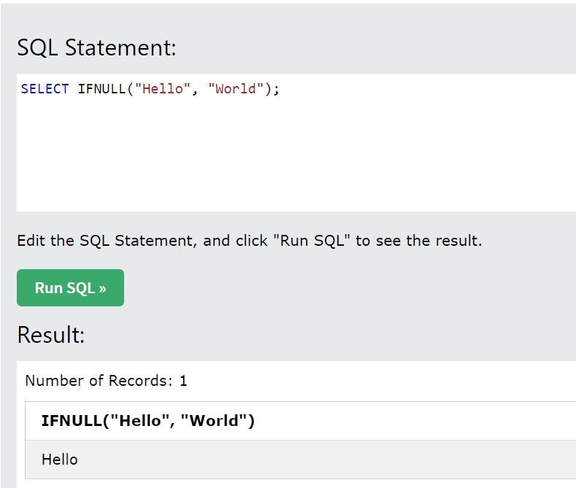
Data Transforming: IFNULL
The IFNULL() function returns a specified value if the expression is NULL.
If the expression is NOT NULL, this function returns the expression.

Slide 8
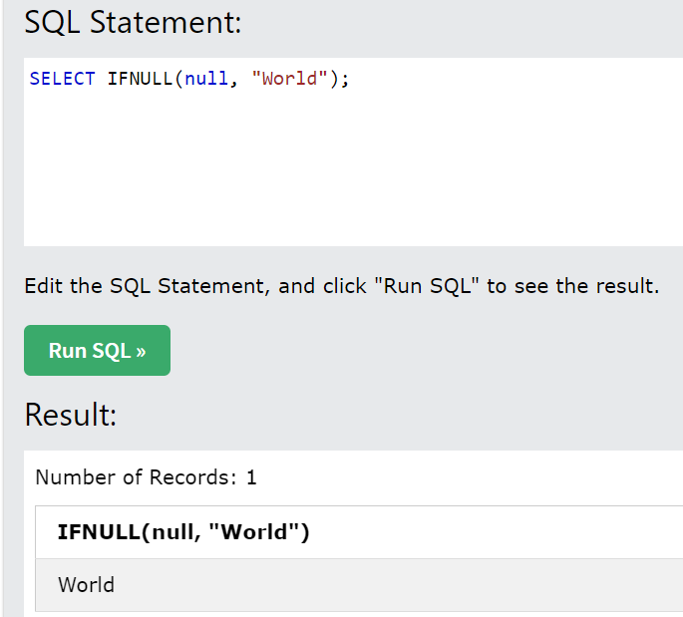
Data Transforming: IFNULL
The IFNULL() function returns a specified value if the expression is NULL.
If the expression is NOT NULL, this function returns the expression.

Slide 9
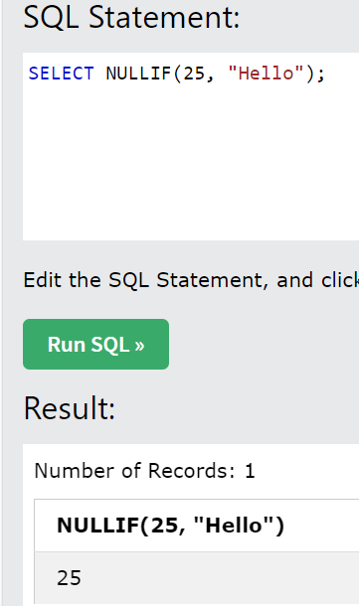
Data Transforming: NULLIF
The NULLIF() function compares two expressions and returns NULL if they are equal. Otherwise, the first expression is returned.

Slide 10
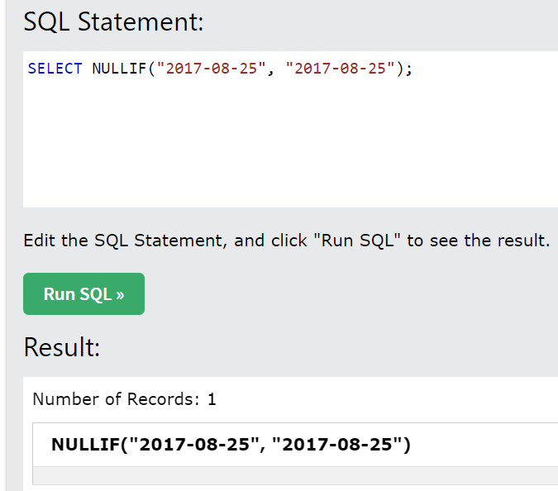
Data Transforming: NULLIF
The NULLIF() function compares two expressions and returns NULL if they are equal. Otherwise, the first expression is returned.

Slide 11
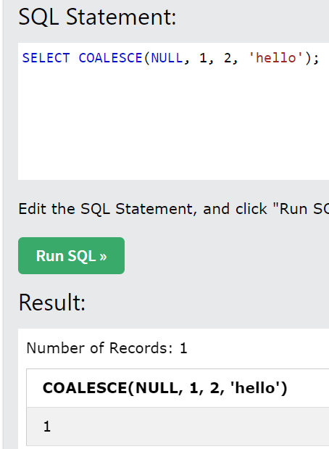
Data Transforming: COALESCE()
The COALESCE() function returns the first non-null value in a list.

Slide 12

Creating Data Storage Objects

Slide 13
Database Objects
Object Description
Table Basic unit of storage; composed of rows and columns
View Logically represents subsets of data from one or more tables
Sequence Numeric value generator
Index Improves the performance of some queries
Synonym Gives alternative names to objects
Notes:
Database Objects
An Oracle database can contain multiple data structures. Each structure should be outlined in the database design so that it can be created during the build stage of database development.
Table: Stores data
View: Subset of data from one or more tables
Sequence: Numeric value generator
Index: Improves the performance of some queries
Synonym: Gives alternative names to objects
Oracle9i Table Structures
Tables can be created at any time, even while users are using the database.
You do not need to specify the size of any table. The size is ultimately defined by the amount of space allocated to the database as a whole. It is important, however, to estimate how much space a table will use over time.
Table structure can be modified online.
Note: More database objects are available but are not covered in this course.
Instructor Note
Tables can have up to 1,000 columns and must conform to standard database object-naming conventions. Column definitions can be omitted when using the AS subquery clause. Tables are created without data unless a query is specified. Rows are usually added by using INSERT statements.

Slide 14
Naming Rules
Table names and column names:
Must begin with a letter
Must be 1–30 characters long
Must contain only A–Z, a–z, 0–9, _, $, and #
Must not duplicate the name of another object owned by the same user
Must not be an Oracle server reserved word
Notes:
Naming Rules
Name database tables and columns according to the standard rules for naming any Oracle database object:
Table names and column names must begin with a letter and be 1–30 characters long.
Names must contain only the characters A–Z, a–z, 0–9, _ (underscore), $, and # (legal characters, but their use is discouraged).
Names must not duplicate the name of another object owned by the same Oracle server user.
Names must not be an Oracle server reserved word.
Naming Guidelines
Use descriptive names for tables and other database objects.
Note: Names are case insensitive. For example, EMPLOYEES is treated as the same name as eMPloyees or eMpLOYEES.
For more information, see Oracle9i SQL Reference,“Object Names and Qualifiers.”

Slide 15
The CREATE TABLE Statement
You must have:
CREATE TABLE privilege
A storage area
You specify:
Table name
Column name, column data type, and column size
CREATE TABLE [schema.]table
(column datatype [DEFAULT expr][, ...]);
Notes:
The CREATE TABLE Statement
Create tables to store data by executing the SQL CREATE TABLE statement. This statement is one of the data definition language (DDL) statements, that are covered in subsequent lessons. DDL statements are a subset of SQL statements used to create, modify, or remove Oracle9i database structures. These statements have an immediate effect on the database, and they also record information in the data dictionary.
To create a table, a user must have the CREATE TABLE privilege and a storage area in which to create objects. The database administrator uses data control language (DCL) statements, which are covered in a later lesson, to grant privileges to users.
In the syntax:
schema is the same as the owner’s name
table is the name of the table
DEFAULT expr specifies a default value if a value is omitted in the INSERT statement
column is the name of the column
datatype is the column’s data type and length
Instructor Note
Please read the Instructor note on page 9-37

Slide 16
Referencing Another User’s Tables
Tables belonging to other users are not in the user’s schema.
You should use the owner’s name as a prefix to those tables.
Notes:
Referencing Another User’s Tables
A schema is a collection of objects. Schema objects are the logical structures that directly refer to the data in a database. Schema objects include tables, views, synonyms, sequences, stored procedures, indexes, clusters, and database links.
If a table does not belong to the user, the owner’s name must be prefixed to the table. For example, if there is a schema named USER_B, and USER_B has an EMPLOYEES table, then specify the following to retrieve data from that table:
SELECT *
FROM user_b.employees;

Slide 17
The DEFAULT Option
Specify a default value for a column during an insert.
Literal values, expressions, or SQL functions are legal values.
Another column’s name or a pseudocolumn are illegal values.
The default data type must match the column data type.
... hire_date DATE DEFAULT SYSDATE, ...
Notes:
The DEFAULT Option
A column can be given a default value by using the DEFAULT option. This option prevents null values from entering the columns if a row is inserted without a value for the column. The default value can be a literal, an expression, or a SQL function, such as SYSDATE and USER, but the value cannot be the name of another column or a pseudocolumn, such as NEXTVAL or CURRVAL. The default expression must match the data type of the column.
Note: CURRVAL and NEXTVAL are explained later.
Instructor Note
Here is an example for a pseudocolumn. For each row returned by a query, the ROWNUM pseudocolumn returns a number indicating the order in which Oracle server selects the row from a table or set of joined rows. The first row selected has a ROWNUM of 1, the second has 2, and so on.
The default value works with the DEFAULT keyword for INSERT and UPDATE statements discussed in the “Manipulating Data” lesson.

Slide 18

Creating Tables
Create the table.
Confirm table creation.
CREATE TABLE dept (deptno NUMBER(2),
dname VARCHAR2(14),
loc VARCHAR2(13));
Table created.
DESCRIBE dept
Notes:
Creating Tables
The example on the slide creates the DEPT table, with three columns: DEPTNO, DNAME, and LOC. It further confirms the creation of the table by issuing the DESCRIBE command.
Since creating a table is a DDL statement, an automatic commit takes place when this statement is executed.
Instructor Note
Explain that additional syntax for CREATE TABLE could include constraints and so on. For more information on the CREATE TABLE syntax, refer to: Oracle9i SQL Reference, “CREATE TABLE. ”

Slide 19
Tables in the Oracle Database
User Tables:
Are a collection of tables created and maintained by the user
Contain user information
Data Dictionary:
Is a collection of tables created and maintained by the Oracle Server
Contain database information
Notes:
Tables in the Oracle Database
User tables are tables created by the user, such as EMPLOYEES. There is another collection of tables and views in the Oracle database known as the data dictionary. This collection is created and maintained by the Oracle server and contains information about the database.
All data dictionary tables are owned by the SYS user. The base tables are rarely accessed by the user because the information in them is not easy to understand. Therefore, users typically access data dictionary views because the information is presented in a format that is easier to understand. Information stored in the data dictionary includes names of the Oracle server users, privileges granted to users, database object names, table constraints, and auditing information.
There are four categories of data dictionary views; each category has a distinct prefix that reflects its intended use.

Slide 20
Querying the Data Dictionary
See the names of tables owned by the user
SELECT table_name
FROM user_tables ;
View distinct types owned by the user
SELECT DISTINCT object_type
FROM user_objects ;
View tables, views, synonyms, and sequences owned by the user
SELECT *
FROM user_catalog ;
Notes:
Querying the Data Dictionary
You can query the data dictionary tables to view various database objects owned by you. The data dictionary tables frequently used are these:
USER_TABLES
USER_OBJECTS
USER_CATALOG
Note: USER_CATALOG has a synonym called CAT. You can use this synonym instead of USER_CATALOG in SQL statements.
SELECT *
FROM CAT;

Slide 21
Data Types
Data Type Description
VARCHAR2(size) Variable-length character data
CHAR(size) Fixed-length character data
NUMBER(p,s) Variable-length numeric data
DATE Date and time values
LONG Variable-length character data up to 2 gigabytes
CLOB Character data up to 4
gigabytes
RAW and LONG RAW Raw binary data
BLOB Binary data up to 4 gigabytes
BFILE Binary data stored in an external file; up to 4 gigabytes
ROWID A 64 base number system representing the unique address of a row in its table.
Notes:
Data Types

Slide 22
Creating a Table by Using a Subquery Syntax
Create a table and insert rows by combining the CREATE TABLE statement and the AS subquery option.
Match the number of specified columns to the number of subquery columns.
Define columns with column names and default values.
CREATE TABLE table
[(column, column...)]
AS subquery;
Notes:
Creating a Table from Rows in Another Table
A second method for creating a table is to apply the AS subquery clause, which both creates the table and inserts rows returned from the subquery.
In the syntax:
table is the name of the table
column is the name of the column, default value, and integrity constraint
subquery is the SELECT statement that defines the set of rows to be inserted into the new table
Guidelines
The table is created with the specified column names, and the rows retrieved by the SELECT statement are inserted into the table.
The column definition can contain only the column name and default value.
If column specifications are given, the number of columns must equal the number of columns in the subquery SELECT list.
If no column specifications are given, the column names of the table are the same as the column names in the subquery.
The integrity rules are not passed onto the new table, only the column data type definitions.

Slide 23
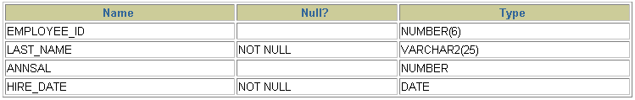
Creating a Table by Using a Subquery
CREATE TABLE dept80
AS SELECT employee_id, last_name,
salary*12 ANNSAL,
hire_date FROM employees WHERE department_id = 80;
Table created.
DESCRIBE dept80
Notes:
Creating a Table from Rows in Another Table (continued)
The slide example creates a table named DEPT80, which contains details of all the employees working in department 80. Notice that the data for the DEPT80 table comes from the EMPLOYEES table.
You can verify the existence of a database table and check column definitions by using the iSQL*Plus DESCRIBE command.
Be sure to give a column alias when selecting an expression. The expression SALARY*12 is given the alias ANNSAL. Without the alias, this error is generated:
ERROR at line 3:
ORA-00998: must name this expression with a column alias
Instructor Note
To create a table with the same structure as an existing table, but without the data from the existing table, use a subquery with a WHERE clause that always evaluates as false. For example:
CREATE TABLE COPY_TABLE AS
(SELECT *
FROM employees
WHERE 1 = 2);

Slide 24
The ALTER TABLE Statement
Use the ALTER TABLE statement to:
Add a new column
Modify an existing column
Define a default value for the new column
Drop a column
Notes:
The ALTER TABLE Statement
After you create a table, you may need to change the table structure because: you omitted a column, your column definition needs to be changed, or you need to remove columns. You can do this by using the ALTER TABLE statement.

Slide 25
The ALTER TABLE Statement
Use the ALTER TABLE statement to add, modify, or
drop columns.
ALTER TABLE table
ADD (column datatype [DEFAULT expr]
[, column datatype]...);
ALTER TABLE table
MODIFY (column datatype [DEFAULT expr]
[, column datatype]...);
ALTER TABLE table
DROP (column);
Notes:
The ALTER TABLE Statement (continued)
You can add, modify, and drop columns to a table by using the ALTER TABLE statement.
In the syntax:
table is the name of the table
ADD|MODIFY|DROP is the type of modification
column is the name of the new column
datatype is the data type and length of the new column
DEFAULT expr specifies the default value for a new column
Note: The slide gives the abridged syntax for ALTER TABLE. More about ALTER TABLE is covered in a subsequent lesson.
Instructor Note
In Oracle8i and later, there are new options for the ALTER TABLE command, including the ability to drop a column from a table, which are covered later in this lesson.

Slide 26

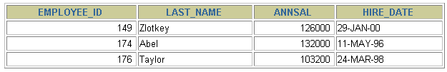
Adding a Column
New column
DEPT80
“Add a new column to the DEPT80 table.”
DEPT80
Notes:
Adding a Column
The graphic adds the JOB_ID column to the DEPT80 table. Notice that the new column becomes the last column in the table.

Slide 27

Adding a Column
You use the ADD clause to add columns.
The new column becomes the last column.
ALTER TABLE dept80
ADD (job_id VARCHAR2(9));
Table altered.
Notes:
Guidelines for Adding a Column
You can add or modify columns.
You cannot specify where the column is to appear. The new column becomes the last column.
The example on the slide adds a column named JOB_ID to the DEPT80 table. The JOB_ID column becomes the last column in the table.
Note: If a table already contains rows when a column is added, then the new column is initially null for all the rows.

Slide 28
Modifying a Column
You can change a column’s data type, size, and default value.
A change to the default value affects only subsequent insertions to the table.
ALTER TABLE dept80
MODIFY (last_name VARCHAR2(30));
Table altered.
Notes:
Modifying a Column
You can modify a column definition by using the ALTER TABLE statement with the MODIFY clause. Column modification can include changes to a column’s data type, size, and default value.
Guidelines
You can increase the width or precision of a numeric column.
You can increase the width of numeric or character columns.
You can decrease the width of a column only if the column contains only null values or if the table has no rows.
You can change the data type only if the column contains null values.
You can convert a CHAR column to the VARCHAR2 data type or convert a VARCHAR2 column to the CHAR data type only if the column contains null values or if you do not change the size.
A change to the default value of a column affects only subsequent insertions to the table.

Slide 29
Dropping a Column
Use the DROP COLUMN clause to drop columns you no
longer need from the table.
ALTER TABLE dept80
DROP COLUMN job_id;
Table altered.
Notes:
Dropping a Column
You can drop a column from a table by using the ALTER TABLE statement with the DROP COLUMN clause. This is a feature available in Oracle8i and later.
Guidelines
The column may or may not contain data.
Using the ALTER TABLE statement, only one column can be dropped at a time.
The table must have at least one column remaining in it after it is altered.
Once a column is dropped, it cannot be recovered.
Instructor Note
When a column is dropped from a table, any other columns in that table that are marked with the SET UNUSED option are dropped too.

Slide 30
Dropping a Table
All data and structure in the table is deleted.
Any pending transactions are committed.
All indexes are dropped.
You cannot roll back the DROP TABLE statement.
DROP TABLE dept80;
Table dropped.
Notes:
Dropping a Table
The DROP TABLE statement removes the definition of an Oracle table. When you drop a table, the database loses all the data in the table and all the indexes associated with it.
Syntax
DROP TABLE table
In the syntax:
table is the name of the table
Guidelines
All data is deleted from the table.
Any views and synonyms remain but are invalid.
Any pending transactions are committed.
Only the creator of the table or a user with the DROP ANY TABLE privilege can remove a table.
Note: The DROP TABLE statement, once executed, is irreversible. The Oracle server does not question the action when you issue the DROP TABLE statement. If you own that table or have a high-level privilege, then the table is immediately removed. As with all DDL statements, DROP TABLE is committed automatically.

Slide 31

Loading Data to Storage

Slide 32
Data Manipulation Language
A DML statement is executed when you:
Add new rows to a table
Modify existing rows in a table
Remove existing rows from a table
A transaction consists of a collection of DML statements that form a logical unit of work.
Notes:
Data Manipulation Language
Data manipulation language (DML) is a core part of SQL. When you want to add, update, or delete data in the database, you execute a DML statement. A collection of DML statements that form a logical unit of work is called a transaction.
Consider a banking database. When a bank customer transfers money from a savings account to a checking account, the transaction might consist of three separate operations: decrease the savings account, increase the checking account, and record the transaction in the transaction journal. The Oracle server must guarantee that all three SQL statements are performed to maintain the accounts in proper balance. When something prevents one of the statements in the transaction from executing, the other statements of the transaction must be undone.
Instructor Note
DML statements can be issued directly in iSQL*Plus, performed automatically by tools such as Oracle Forms Services, or programmed with tools such as the 3GL precompilers.
Every table has INSERT, UPDATE, and DELETE privileges associated with it. These privileges are automatically granted to the creator of the table, but in general they must be explicitly granted to other users.
Starting with Oracle 7.2, you can place a subquery in the place of the table name in an UPDATE statement, essentially the same way you use a view.

Slide 33
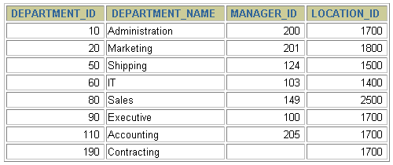
Adding a New Row to a Table
New
row
DEPARTMENTS
…insert a new row into the DEPARMENTS table…
Notes:
Adding a New Row to a Table
The slide graphic illustrates adding a new department to the DEPARTMENTS table.

Slide 34
The INSERT Statement Syntax
Add new rows to a table by using the INSERT statement.
Only one row is inserted at a time with this syntax.
INSERT INTO table [(column [, column...])]
VALUES (value [, value...]);
Notes:
Adding a New Row to a Table (continued)
You can add new rows to a table by issuing the INSERT statement.
In the syntax:
table is the name of the table
column is the name of the column in the table to populate
value is the corresponding value for the column
Note: This statement with the VALUES clause adds only one row at a time to a table.

Slide 35
Inserting New Rows
Insert a new row containing values for each column.
List values in the default order of the columns in the table.
Optionally, list the columns in the INSERT clause.
Enclose character and date values within single quotation marks.
INSERT INTO departments(department_id, department_name,
manager_id, location_id)
VALUES (70, 'Public Relations', 100, 1700);
1 row created.
Notes:
Adding a New Row to a Table (continued)
Because you can insert a new row that contains values for each column, the column list is not required in the INSERT clause. However, if you do not use the column list, the values must be listed according to the default order of the columns in the table, and a value must be provided for each column.
DESCRIBE departments
For clarity, use the column list in the INSERT clause. Enclose character and date values within single quotation marks; it is not recommended to enclose numeric values within single quotation marks.
Number values should not be enclosed in single quotes, because implicit conversion may take place for numeric values assigned to NUMBER data type columns if single quotes are included.

Slide 36
Inserting Rows with Null Values
Implicit method: Omit the column from the column list.
INSERT INTO departments (department_id,
department_name )
VALUES (30, 'Purchasing');
1 row created.
Explicit method: Specify the NULL keyword in the VALUES clause.
INSERT INTO departments
VALUES (100, 'Finance', NULL, NULL);
1 row created.
Notes:
Methods for Inserting Null Values
Be sure that you can use null values in the targeted column by verifying the Null? status with the iSQL*Plus DESCRIBE command.
The Oracle Server automatically enforces all data types, data ranges, and data integrity constraints. Any column that is not listed explicitly obtains a null value in the new row.
Common errors that can occur during user input:
Mandatory value missing for a NOT NULL column
Duplicate value violates uniqueness constraint
Foreign key constraint violated
CHECK constraint violated
Data type mismatch
Value too wide to fit in column

Slide 37
Inserting Special Values
The SYSDATE function records the current date
and time.
INSERT INTO employees (employee_id,
first_name, last_name,
email, phone_number,
hire_date, job_id, salary,
commission_pct, manager_id,
department_id)
VALUES (113,
'Louis', 'Popp',
'LPOPP', '515.124.4567',
SYSDATE, 'AC_ACCOUNT', 6900,
NULL, 205, 100);
1 row created.
Notes:
Inserting Special Values by Using SQL Functions
You can use functions to enter special values in your table.
The slide example records information for employee Popp in the EMPLOYEES table. It supplies the current date and time in the HIRE_DATE column. It uses the SYSDATE function for current date and time.
You can also use the USER function when inserting rows in a table. The USER function records the current username.
Confirming Additions to the Table
SELECT employee_id, last_name, job_id, hire_date, commission_pct
FROM employees
WHERE employee_id = 113;

Slide 38
Inserting Specific Date Values
Add a new employee.
Verify your addition.
INSERT INTO employees
VALUES (114,
'Den', 'Raphealy',
'DRAPHEAL', '515.127.4561',
TO_DATE('FEB 3, 1999', 'MON DD, YYYY'),
'AC_ACCOUNT', 11000, NULL, 100, 30);
1 row created.
Notes:
Inserting Specific Date and Time Values
The DD-MON-YY format is usually used to insert a date value. With this format, recall that the century defaults to the current century. Because the date also contains time information, the default time is midnight (00:00:00).
If a date must be entered in a format other than the default format, for example, with another century, or a specific time, you must use the TO_DATE function.
The example on the slide records information for employee Raphealy in the EMPLOYEES table. It sets the HIRE_DATE column to be February 3, 1999. If you use the following statement instead of the one shown on the slide, the year of the hire_date is interpreted as 2099.
INSERT INTO employees
VALUES (114,
'Den', 'Raphealy',
'DRAPHEAL', '515.127.4561',
'03-FEB-99',
'AC_ACCOUNT', 11000, NULL, 100, 30);
If the RR format is used, the system provides the correct century automatically, even if it is not the current one.
Instructor Note
The default date format in Oracle9i is DD-MON-RR. Prior to release 8.16, the default format was DD-MON-YY.

Slide 39
Copying Rows from Another Table
Write your INSERT statement with a subquery.
Do not use the VALUES clause.
Match the number of columns in the INSERT clause to those in the subquery.
INSERT INTO sales_reps(id, name, salary, commission_pct)
SELECT employee_id, last_name, salary, commission_pct
FROM employees
WHERE job_id LIKE '%REP%';
4 rows created.
Notes:
Copying Rows from Another Table
You can use the INSERT statement to add rows to a table where the values are derived from existing tables. In place of the VALUES clause, you use a subquery.
Syntax
INSERT INTO table [ column (, column) ] subquery;
In the syntax:
table is the table name
column is the name of the column in the table to populate
subquery is the subquery that returns rows into the table
The number of columns and their data types in the column list of the INSERT clause must match the number of values and their data types in the subquery. To create a copy of the rows of a table, use SELECT * in the subquery.
INSERT INTO copy_emp
SELECT *
FROM employees;
For more information, see Oracle9i SQL Reference, “SELECT,” subqueries section.
Instructor Note
Please run the script 8_cretabs.sql to create the COPY_EMP and SALES_REPS tables before demonstrating the code examples. Do not get into too many details on copying rows from another table.

Slide 40
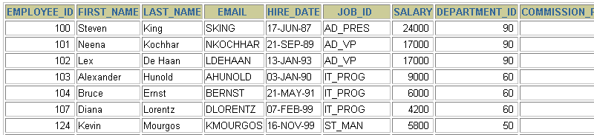
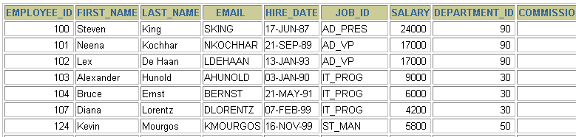
Changing Data in a Table
EMPLOYEES
Update rows in the EMPLOYEES table.
Notes:
Changing Data in a Table
The slide graphic illustrates changing the department number for employees in department 60 to department 30.

Slide 41
The UPDATE Statement Syntax
Modify existing rows with the UPDATE statement.
Update more than one row at a time, if required.
UPDATE table
SET column = value [, column = value, ...]
[WHERE condition];
Notes:
Updating Rows
You can modify existing rows by using the UPDATE statement.
In the syntax:
table is the name of the table
column is the name of the column in the table to populate
value is the corresponding value or subquery for the column
condition identifies the rows to be updated and is composed of column names expressions, constants, subqueries, and comparison operators
Confirm the update operation by querying the table to display the updated rows.
For more information, see Oracle9i SQL Reference, “UPDATE.”
Note: In general, use the primary key to identify a single row. Using other columns can unexpectedly cause several rows to be updated. For example, identifying a single row in the EMPLOYEES table by name is dangerous, because more than one employee may have the same name.

Slide 42
Updating Rows in a Table
Specific row or rows are modified if you specify the WHERE clause.
All rows in the table are modified if you omit the WHERE clause.
UPDATE employees
SET department_id = 70
WHERE employee_id = 113;
1 row updated.
UPDATE copy_emp
SET department_id = 110;
22 rows updated.
Notes:
Updating Rows (continued)
The UPDATE statement modifies specific rows if the WHERE clause is specified. The slide example transfers employee 113 (Popp) to department 70.
If you omit the WHERE clause, all the rows in the table are modified.
SELECT last_name, department_id
FROM copy_emp;
Note: The COPY_EMP table has the same data as the EMPLOYEES table.
…

Slide 43
Problem
Update employee 114’s job and salary to match that of employee 205.

Slide 44
Updating Two Columns with a Subquery
Update employee 114’s job and salary to match that of
employee 205.
UPDATE employees
SET job_id = (SELECT job_id
FROM employees
WHERE employee_id = 205),
salary = (SELECT salary
FROM employees
WHERE employee_id = 205)
WHERE employee_id = 114;
1 row updated.
Notes:
Updating Two Columns with a Subquery
You can update multiple columns in the SET clause of an UPDATE statement by writing multiple subqueries.
Syntax
UPDATE table
SET column =
(SELECT column
FROM table
WHERE condition)
[ ,
column =
(SELECT column
FROM table
WHERE condition)]
[WHERE condition ] ;
Note: If no rows are updated, a message “0 rows updated.” is returned.

Slide 45
Problem
Updates the COPY_EMP table based on the values from the EMPLOYEES table. It changes the department number of all employees with employee 200’s job ID to employee 100’s current department number.

Slide 46
Updating Rows Based on Another Table
Use subqueries in UPDATE statements to update
rows in a table based on values from another table.
UPDATE copy_emp
SET department_id = (SELECT department_id
FROM employees
WHERE employee_id = 100)
WHERE job_id = (SELECT job_id
FROM employees
WHERE employee_id = 200);
1 row updated.
Notes:
Updating Rows Based on Another Table
You can use subqueries in UPDATE statements to update rows in a table. The example on the slide updates the COPY_EMP table based on the values from the EMPLOYEES table. It changes the department number of all employees with employee 200’s job ID to employee 100’s current department number.

Slide 47
Updating Rows: Integrity Constraint Error
UPDATE employees
SET department_id = 55
WHERE department_id = 110;
UPDATE employees
*
ERROR at line 1:
ORA-02291: integrity constraint (HR.EMP_DEPT_FK) violated - parent key not found
Department number 55 does not exist
Notes:
Integrity Constraint Error
If you attempt to update a record with a value that is tied to an integrity constraint, an error is returned.
In the example on the slide, department number 55 does not exist in the parent table, DEPARTMENTS, and so you receive the parent key violation ORA-02291.
Note: Integrity constraints ensure that the data adheres to a predefined set of rules. A subsequent lesson covers integrity constraints in greater depth.
Instructor Note
Explain integrity constraints, and review the concepts of primary key and foreign key.

Slide 48
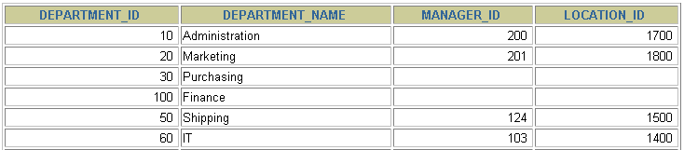
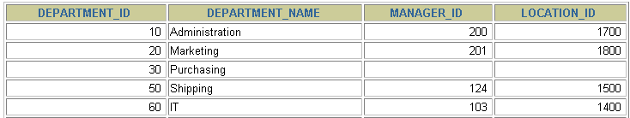
Removing a Row from a Table
DEPARTMENTS
Delete a row from the DEPARTMENTS table.
Notes:
Removing a Row from a Table
The slide graphic removes the Finance department from the DEPARTMENTS table (assuming that there are no constraints defined on the DEPARTMENTS table).
Instructor Note
After all the rows have been eliminated with the DELETE statement, only the data structure of the table remains. A more efficient method of emptying a table is with the TRUNCATE statement. You can use the TRUNCATE statement to quickly remove all rows from a table or cluster. Removing rows with the TRUNCATE statement is faster than removing them with the DELETE statement for the following reasons:
The TRUNCATE statement is a data definition language (DDL) statement and generates no rollback information. It is covered in a subsequent lesson.
Truncating a table does not fire the delete triggers of the table.
If the table is the parent of a referential integrity constraint, you cannot truncate the table. Disable the constraint before issuing the TRUNCATE statement.

Slide 49
The DELETE Statement
You can remove existing rows from a table by using
the DELETE statement.
DELETE [FROM] table
[WHERE condition];
Notes:
Deleting Rows
You can remove existing rows by using the DELETE statement.
In the syntax:
table is the table name condition identifies the rows to be deleted and is composed of column names, expressions, constants, subqueries, and comparison operators
Note: If no rows are deleted, a message “0 rows deleted.” is returned:
For more information, see Oracle9i SQL Reference, “DELETE.”
Instructor Note
The DELETE statement does not ask for confirmation. However, the delete operation is not made permanent until the data transaction is committed. Therefore, you can undo the operation with the ROLLBACK statement if you make a mistake.

Slide 50
Deleting Rows from a Table
Specific rows are deleted if you specify the WHERE clause.
All rows in the table are deleted if you omit the WHERE clause.
DELETE FROM departments
WHERE department_name = 'Finance';
1 row deleted.
DELETE FROM copy_emp;
22 rows deleted.
Notes:
Deleting Rows (continued)
You can delete specific rows by specifying the WHERE clause in the DELETE statement. The slide example deletes the Finance department from the DEPARTMENTS table. You can confirm the delete operation by displaying the deleted rows using the SELECT statement.
SELECT *
FROM departments
WHERE department_name = 'Finance';
no rows selected.
If you omit the WHERE clause, all rows in the table are deleted. The second example on the slide deletes all the rows from the COPY_EMP table, because no WHERE clause has been specified.
Example
Remove rows identified in the WHERE clause.
DELETE FROM employees
WHERE employee_id = 114;
1 row deleted.
DELETE FROM departments
WHERE department_id IN (30, 40);
2 rows deleted.

Slide 51
Deleting Rows Based on Another Table
Use subqueries in DELETE statements to remove
rows from a table based on values from another table.
DELETE FROM employees
WHERE department_id =
(SELECT department_id
FROM departments
WHERE department_name LIKE '%Public%');
1 row deleted.
Notes:
Deleting Rows Based on Another Table
You can use subqueries to delete rows from a table based on values from another table. The example on the slide deletes all the employees who are in a department where the department name contains the string “Public.” The subquery searches the DEPARTMENTS table to find the department number based on the department name containing the string “Public.” The subquery then feeds the department number to the main query, which deletes rows of data from the EMPLOYEES table based on this department number.

Slide 52


Slide 53

Happy Learning!

